Slide 1
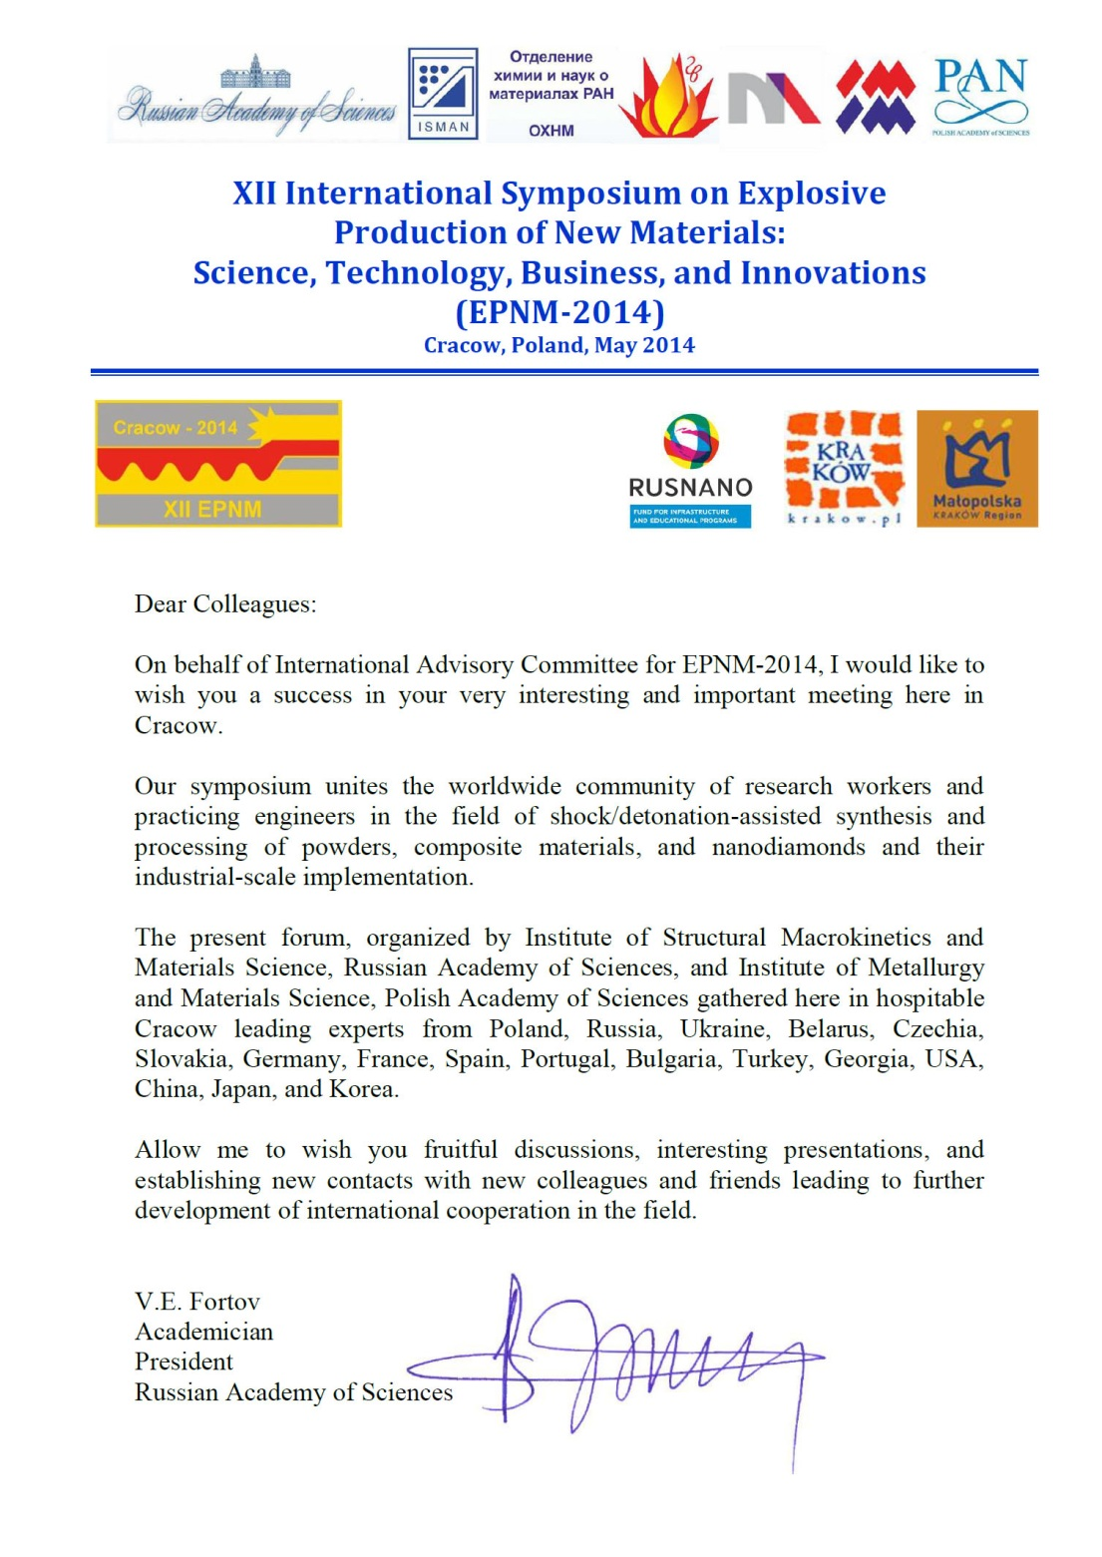
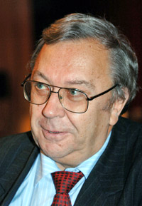
V.E. Fortov
Academician
President Russian Academy of Sciences

Slide 2
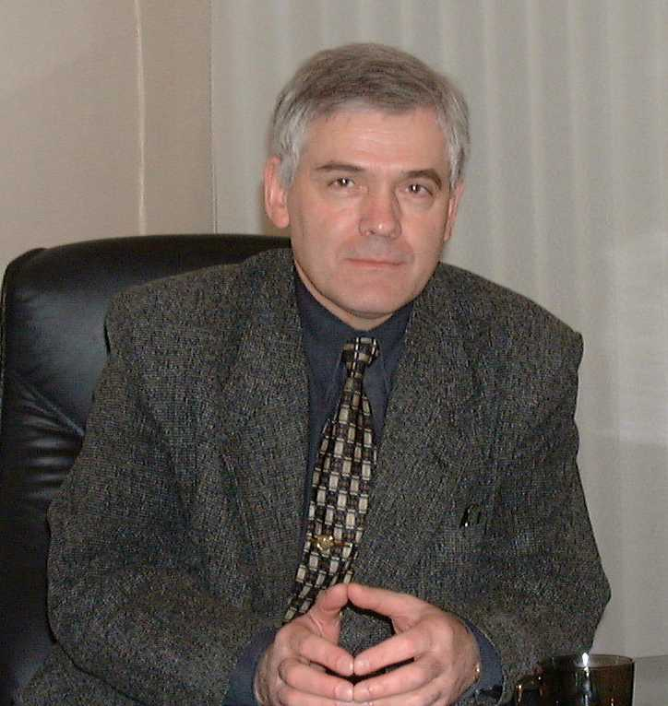
12.12.1948 – 14.06.2012
Prof. Yury Aleksandrovich Gorgopolov
World-famous scientist in the field of modification, synthesis,
and explosive welding of materials

Slide 3
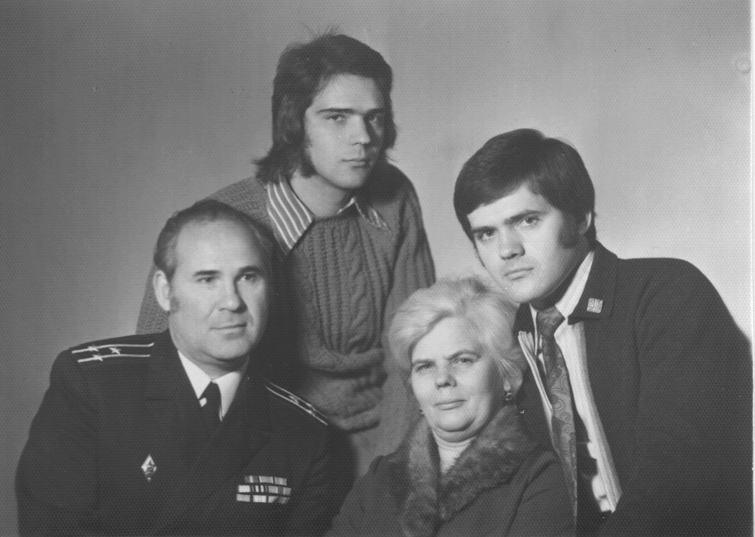
The family

Slide 4
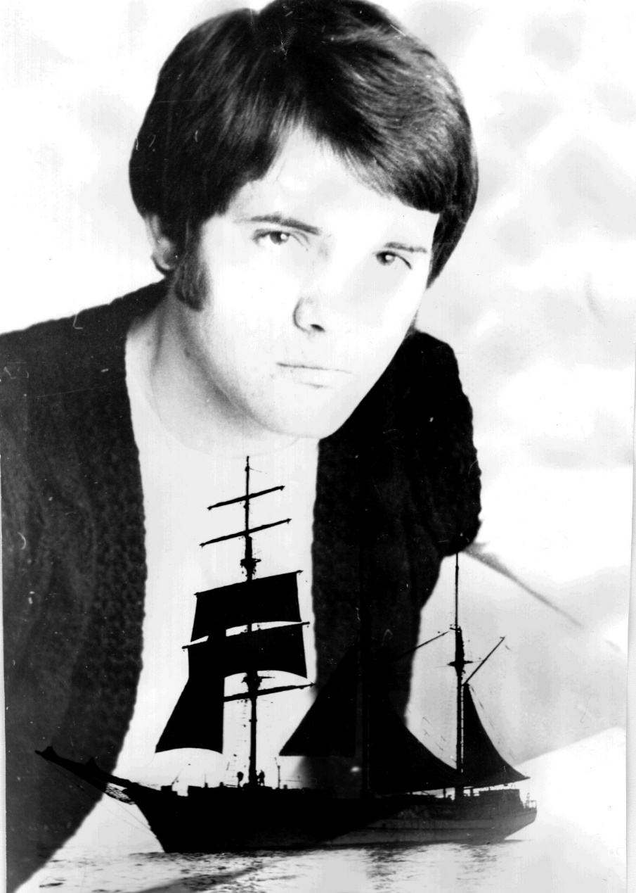
High-school graduate
(Kaliningrad–Königsberg, 1966)

Slide 5
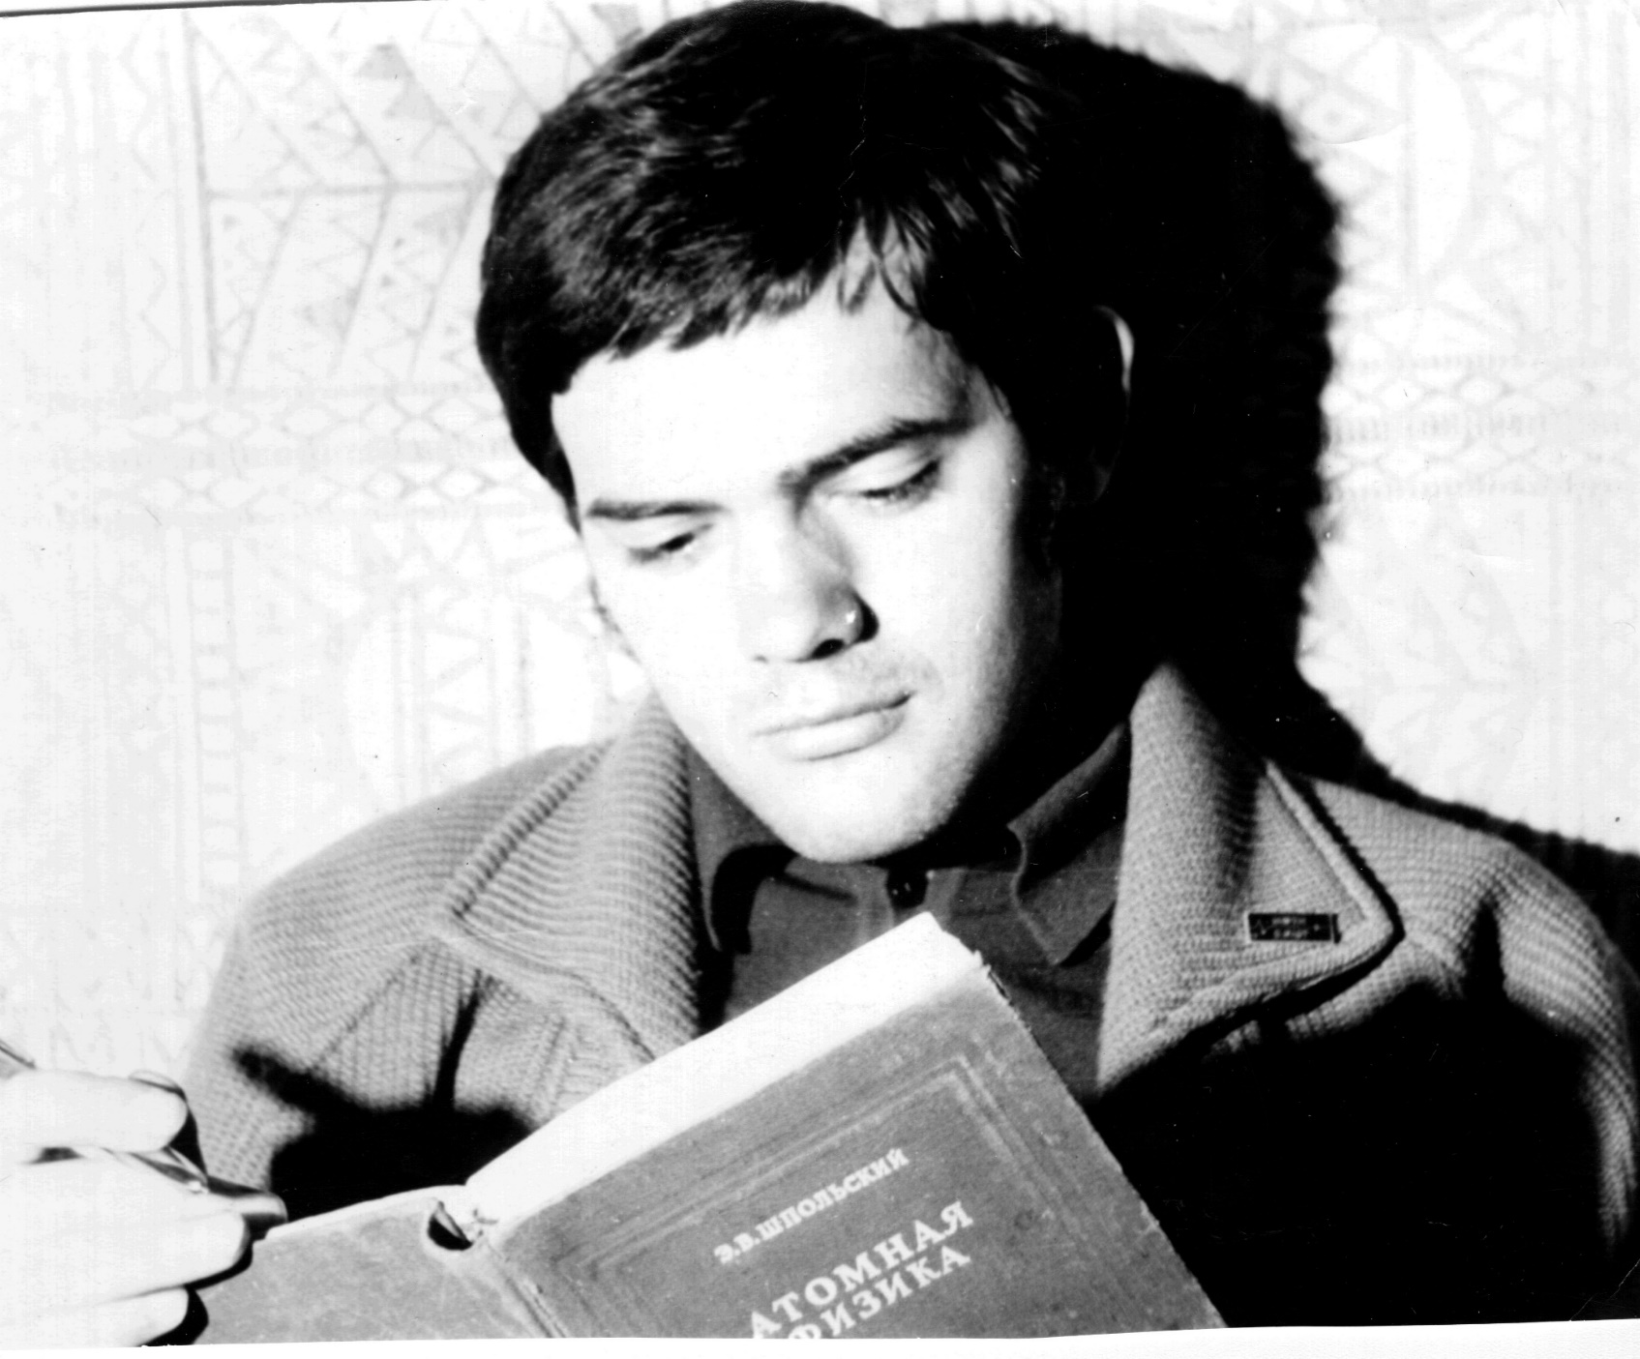
Third-year student
(Dolgoprudnyi–Moscow,
1970)
Having graduated from Moscow Institute of Physics and Technology, in 1973, Yu.A.Gordopolov began his research work at the Institute of Chemical Physics, and got his Cand. Sc. degree in 1977, under supervision of Prof. A.N. Dremin.

Slide 6
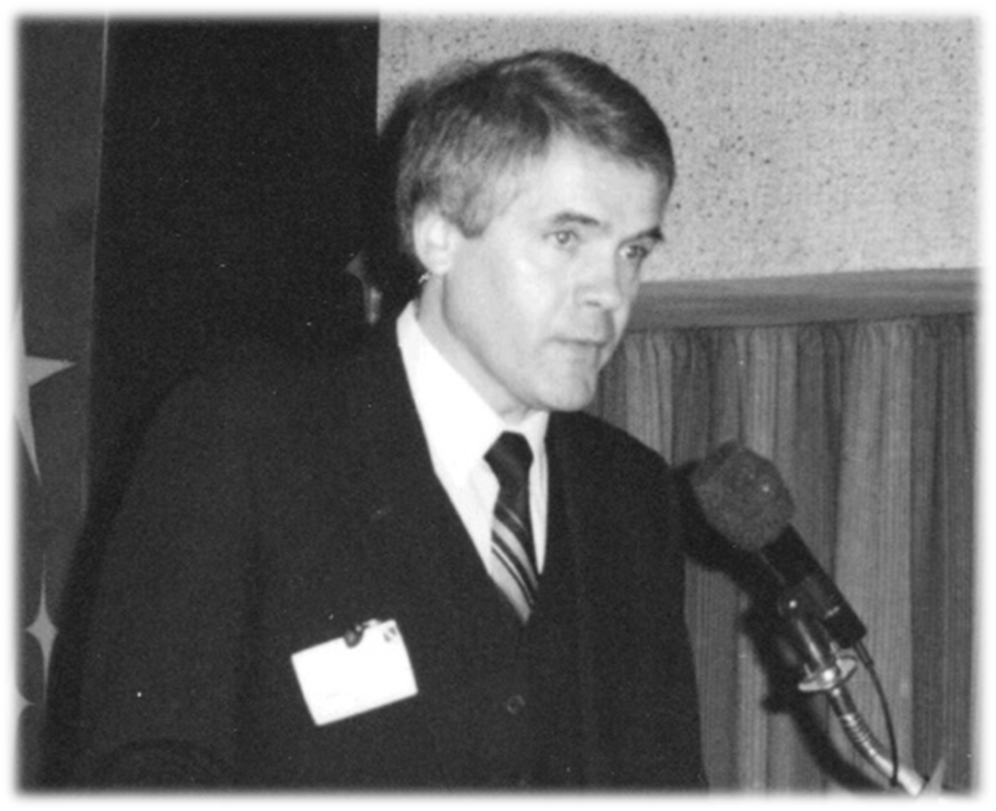
Institute of
Chemical Physics
(Chernogolovka, 1978)
His interests covered the behavior of metals in conditions of shock loading and high-speed impact.
In the 80s, Gordopolov initiated his studies on the influence of shock loading on SHS reactions and on the possibility of solid state detonation.
Gordopolov has got his D.Sc. degree in 1991 and the academic title of professor in 1994.

Slide 7
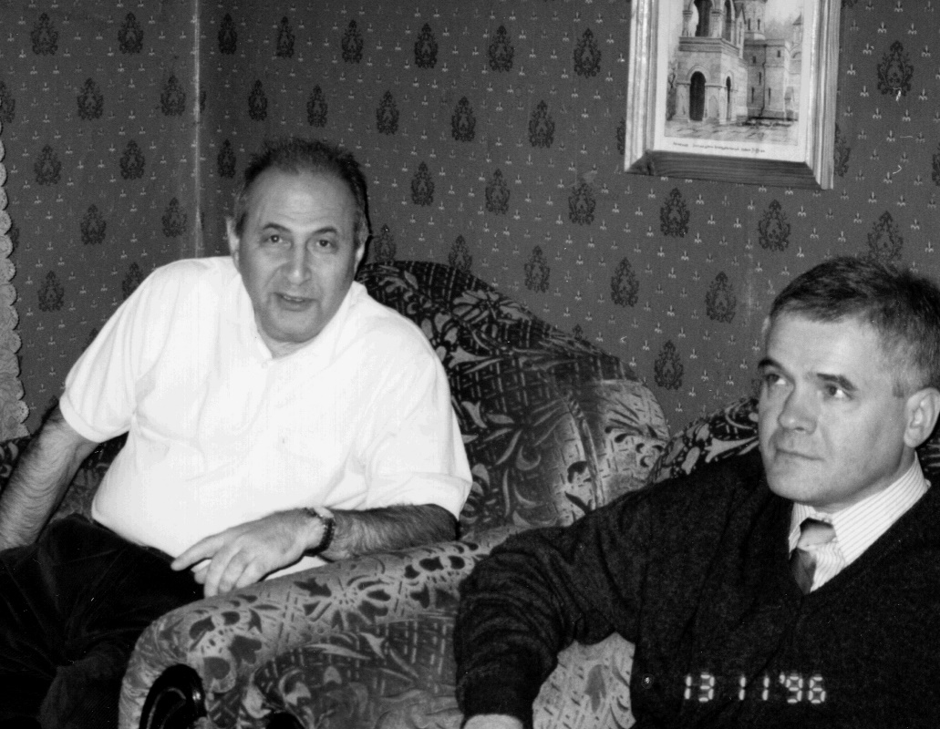
With academician A.G. Merzhanov
(Chernogolovka, 1996)

Slide 8
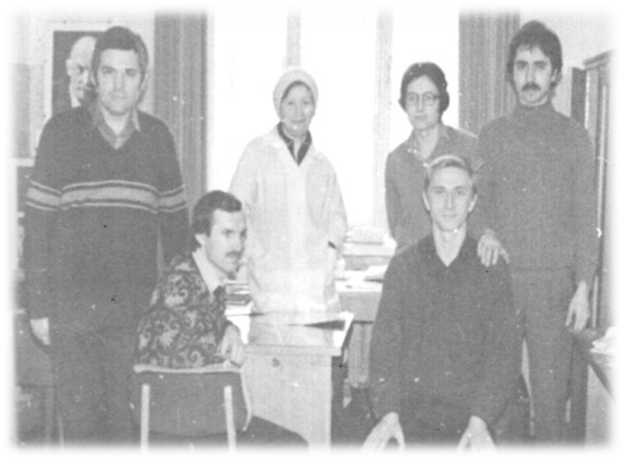
The followers:
The members of the lab
Zotov, Molokov,
Fedorov, Shikhverdiev.
He was the first who gave theoretical explanation for formation of the wavy structure at the interface upon high-speed impact of two metal surfaces.
These results made a theoretical basis for the technology of explosive welding.

Slide 9
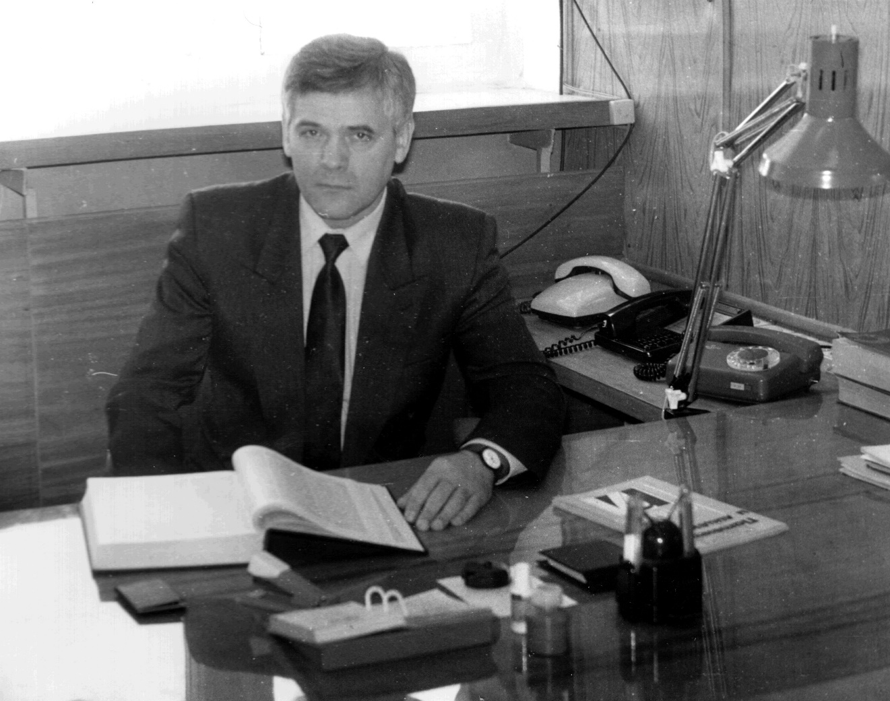
Deputy director ISMAN
Prof. Gordopolov was a dedicated scientist who did much in promoting R & D in the field of explosion-aided synthesis and modification of materials.
He has discovered the shock-induced quenching of shock wave and suggested several methods for synthesis of fine-grained materials with unique properties.

Slide 10
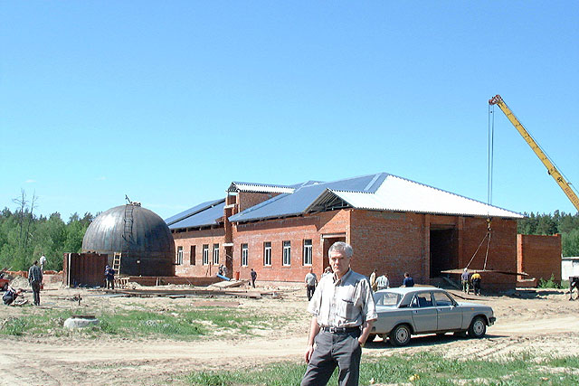
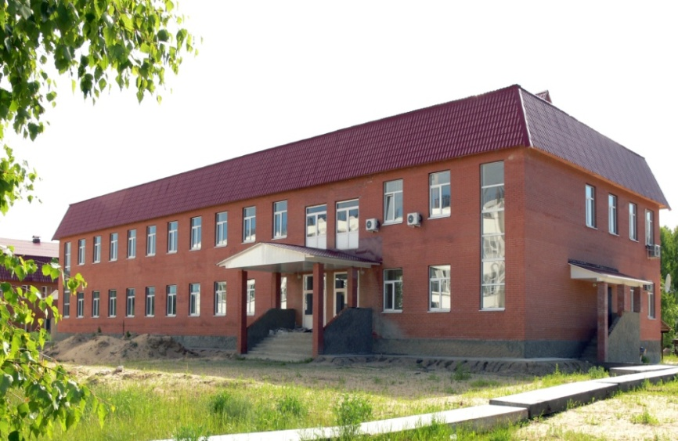
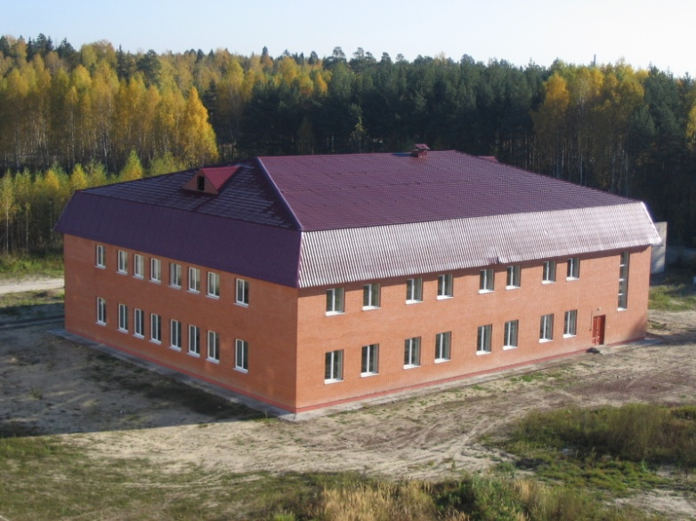
New ISMAN buildings:
Explosion site
Dormitory
Innovative center

Slide 11
Annual school-seminar for younger scientists
(ISMAN, Chernogolovka)

Slide 12
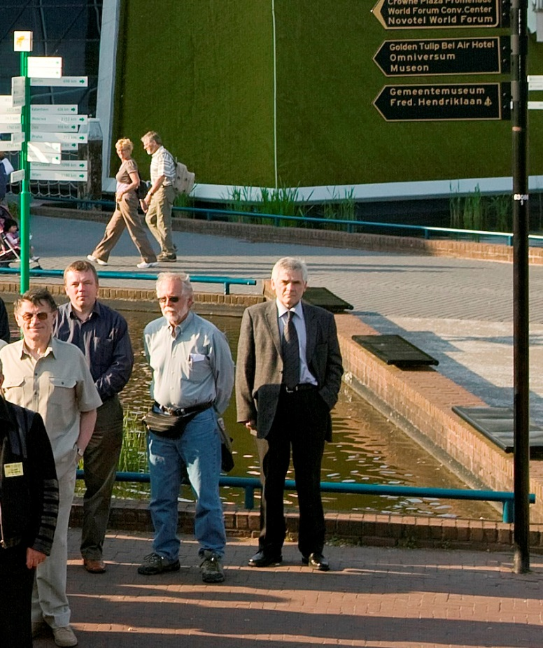
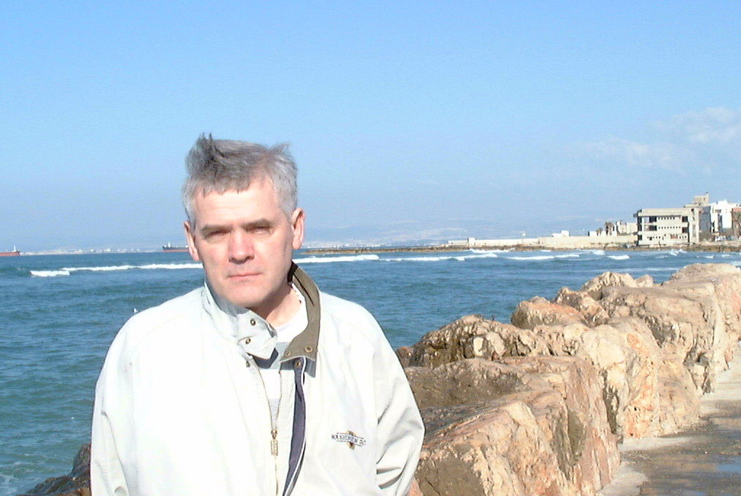
International meetings
SHS-2002
Haifa, Israel
EPNM-2008
Netherlands

Slide 13
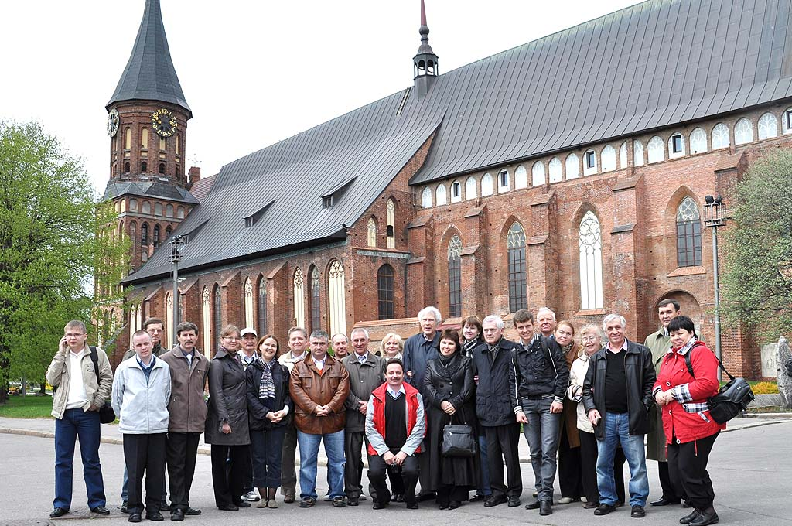
International Workshop on Explosion/Combustion-Assisted Production
of New Materials
(Svetlogorsk, Russia, 2011)
In the 2000s, Yury Gordopolov resumed the tradition of regular international forums on shock waves—such as High-Energy-Rate Fabrication (HERF), Shock-Wave and High-Strain-Rate Phenomena (EXPLOMET), and International Symposia in Czechoslovakia—and organized, in continuation of this tradition, the VIII International Symposium on Application of Explosion to Preparation of New Materials (Moscow, 2006), first in the new EPNM series.

Slide 14
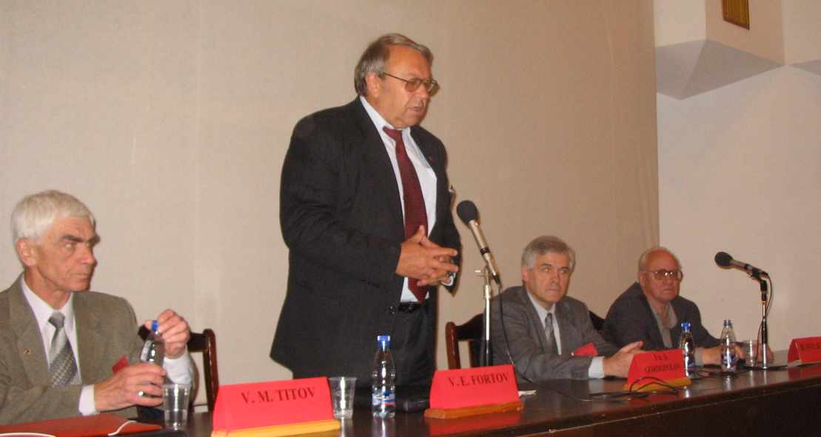
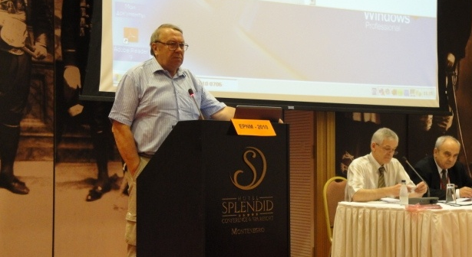
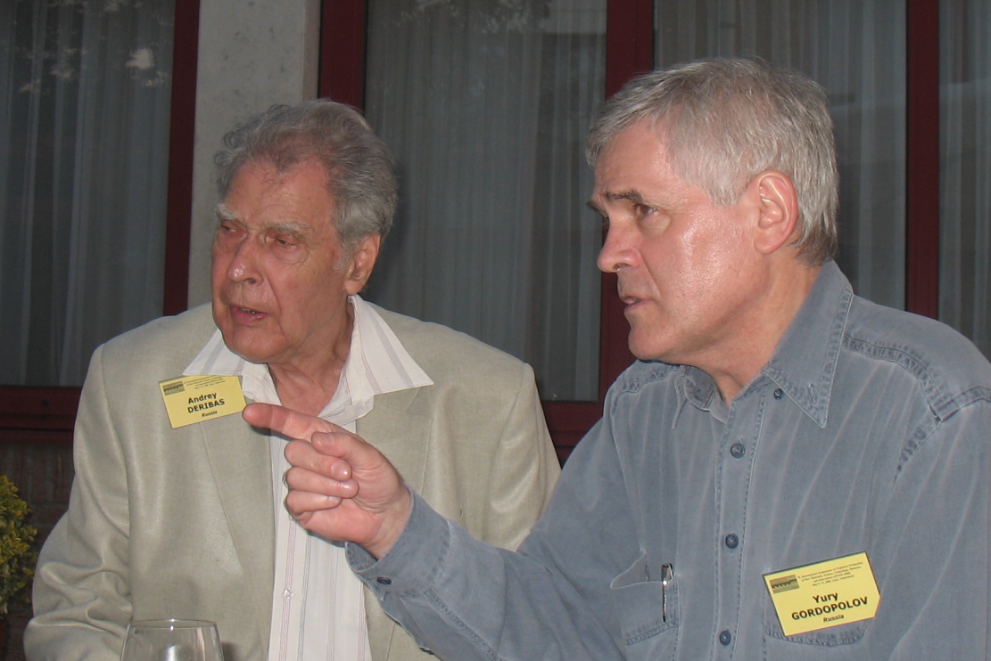
EPNM
Academician Vladimir Fortov
Andrey Deribas, Yury Gordopolov

Slide 15
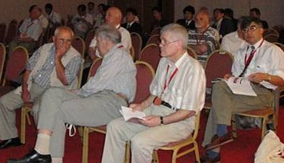
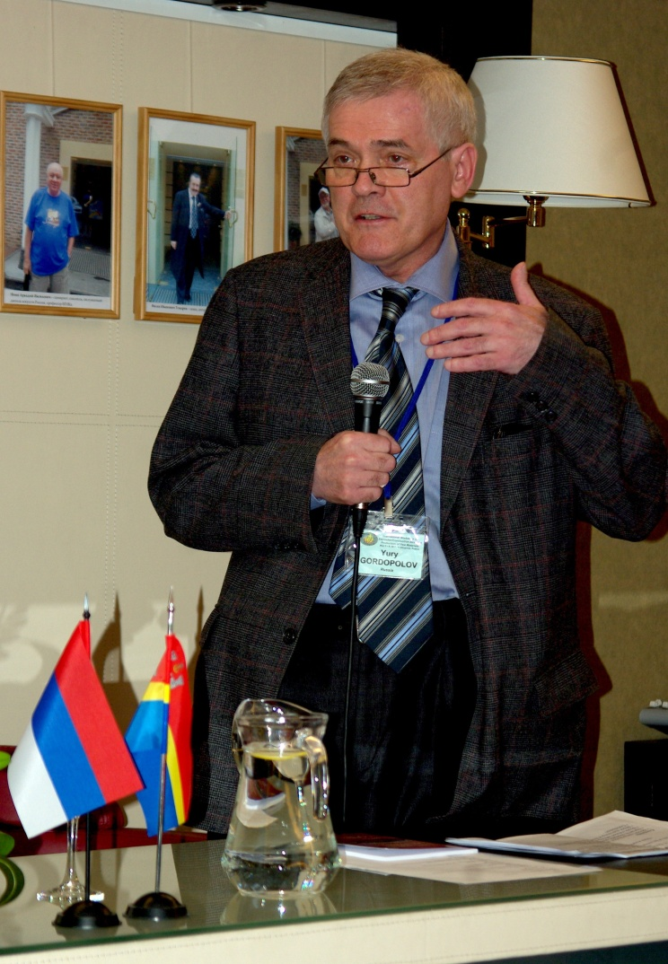
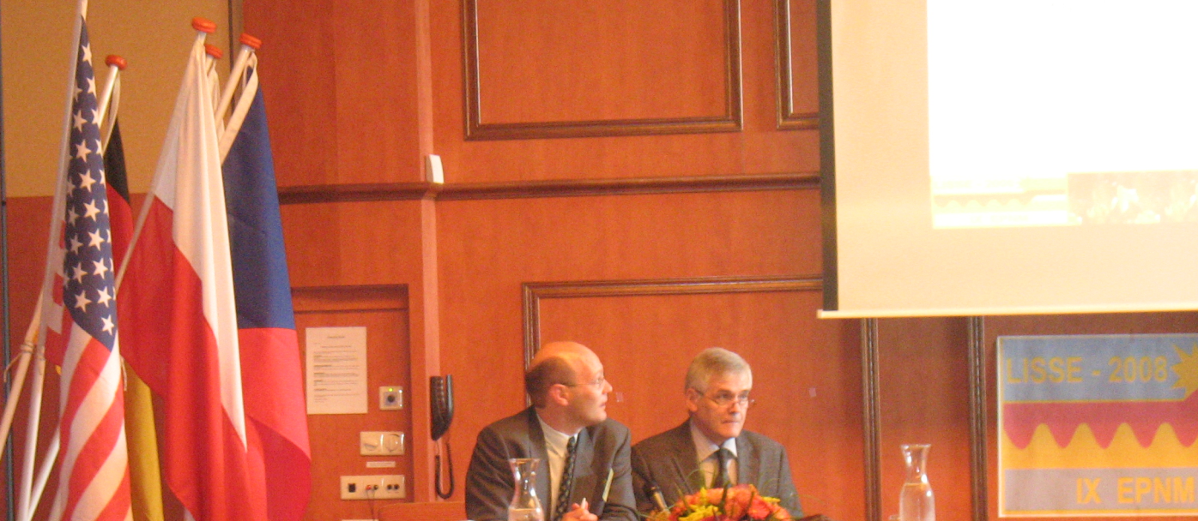
EPNM
Erik Carton, Yurii Gordopolov

Slide 16
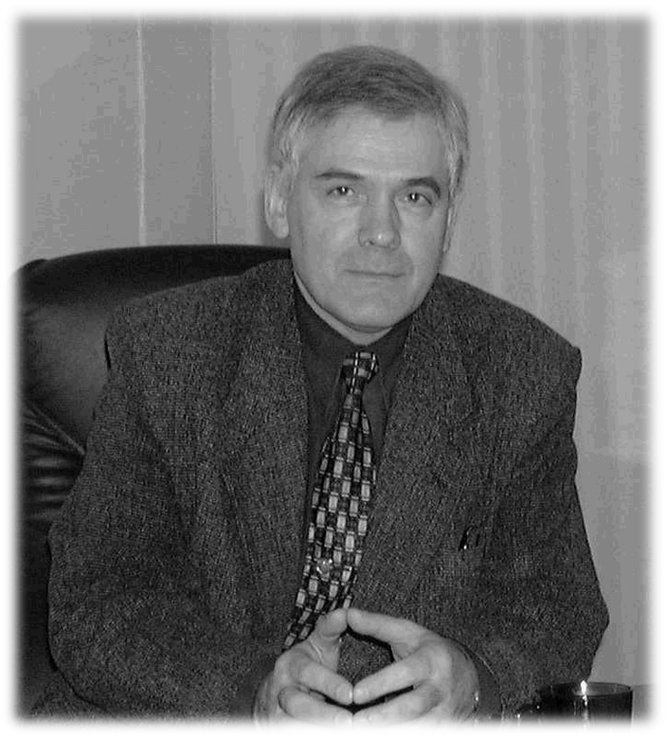
12.12.1948 – 14.06.2012

